Slide 1

Agent Activity Chart
6/26/2022 9:42 PM
Print User : automation
Page 1 of 3

Slide 2
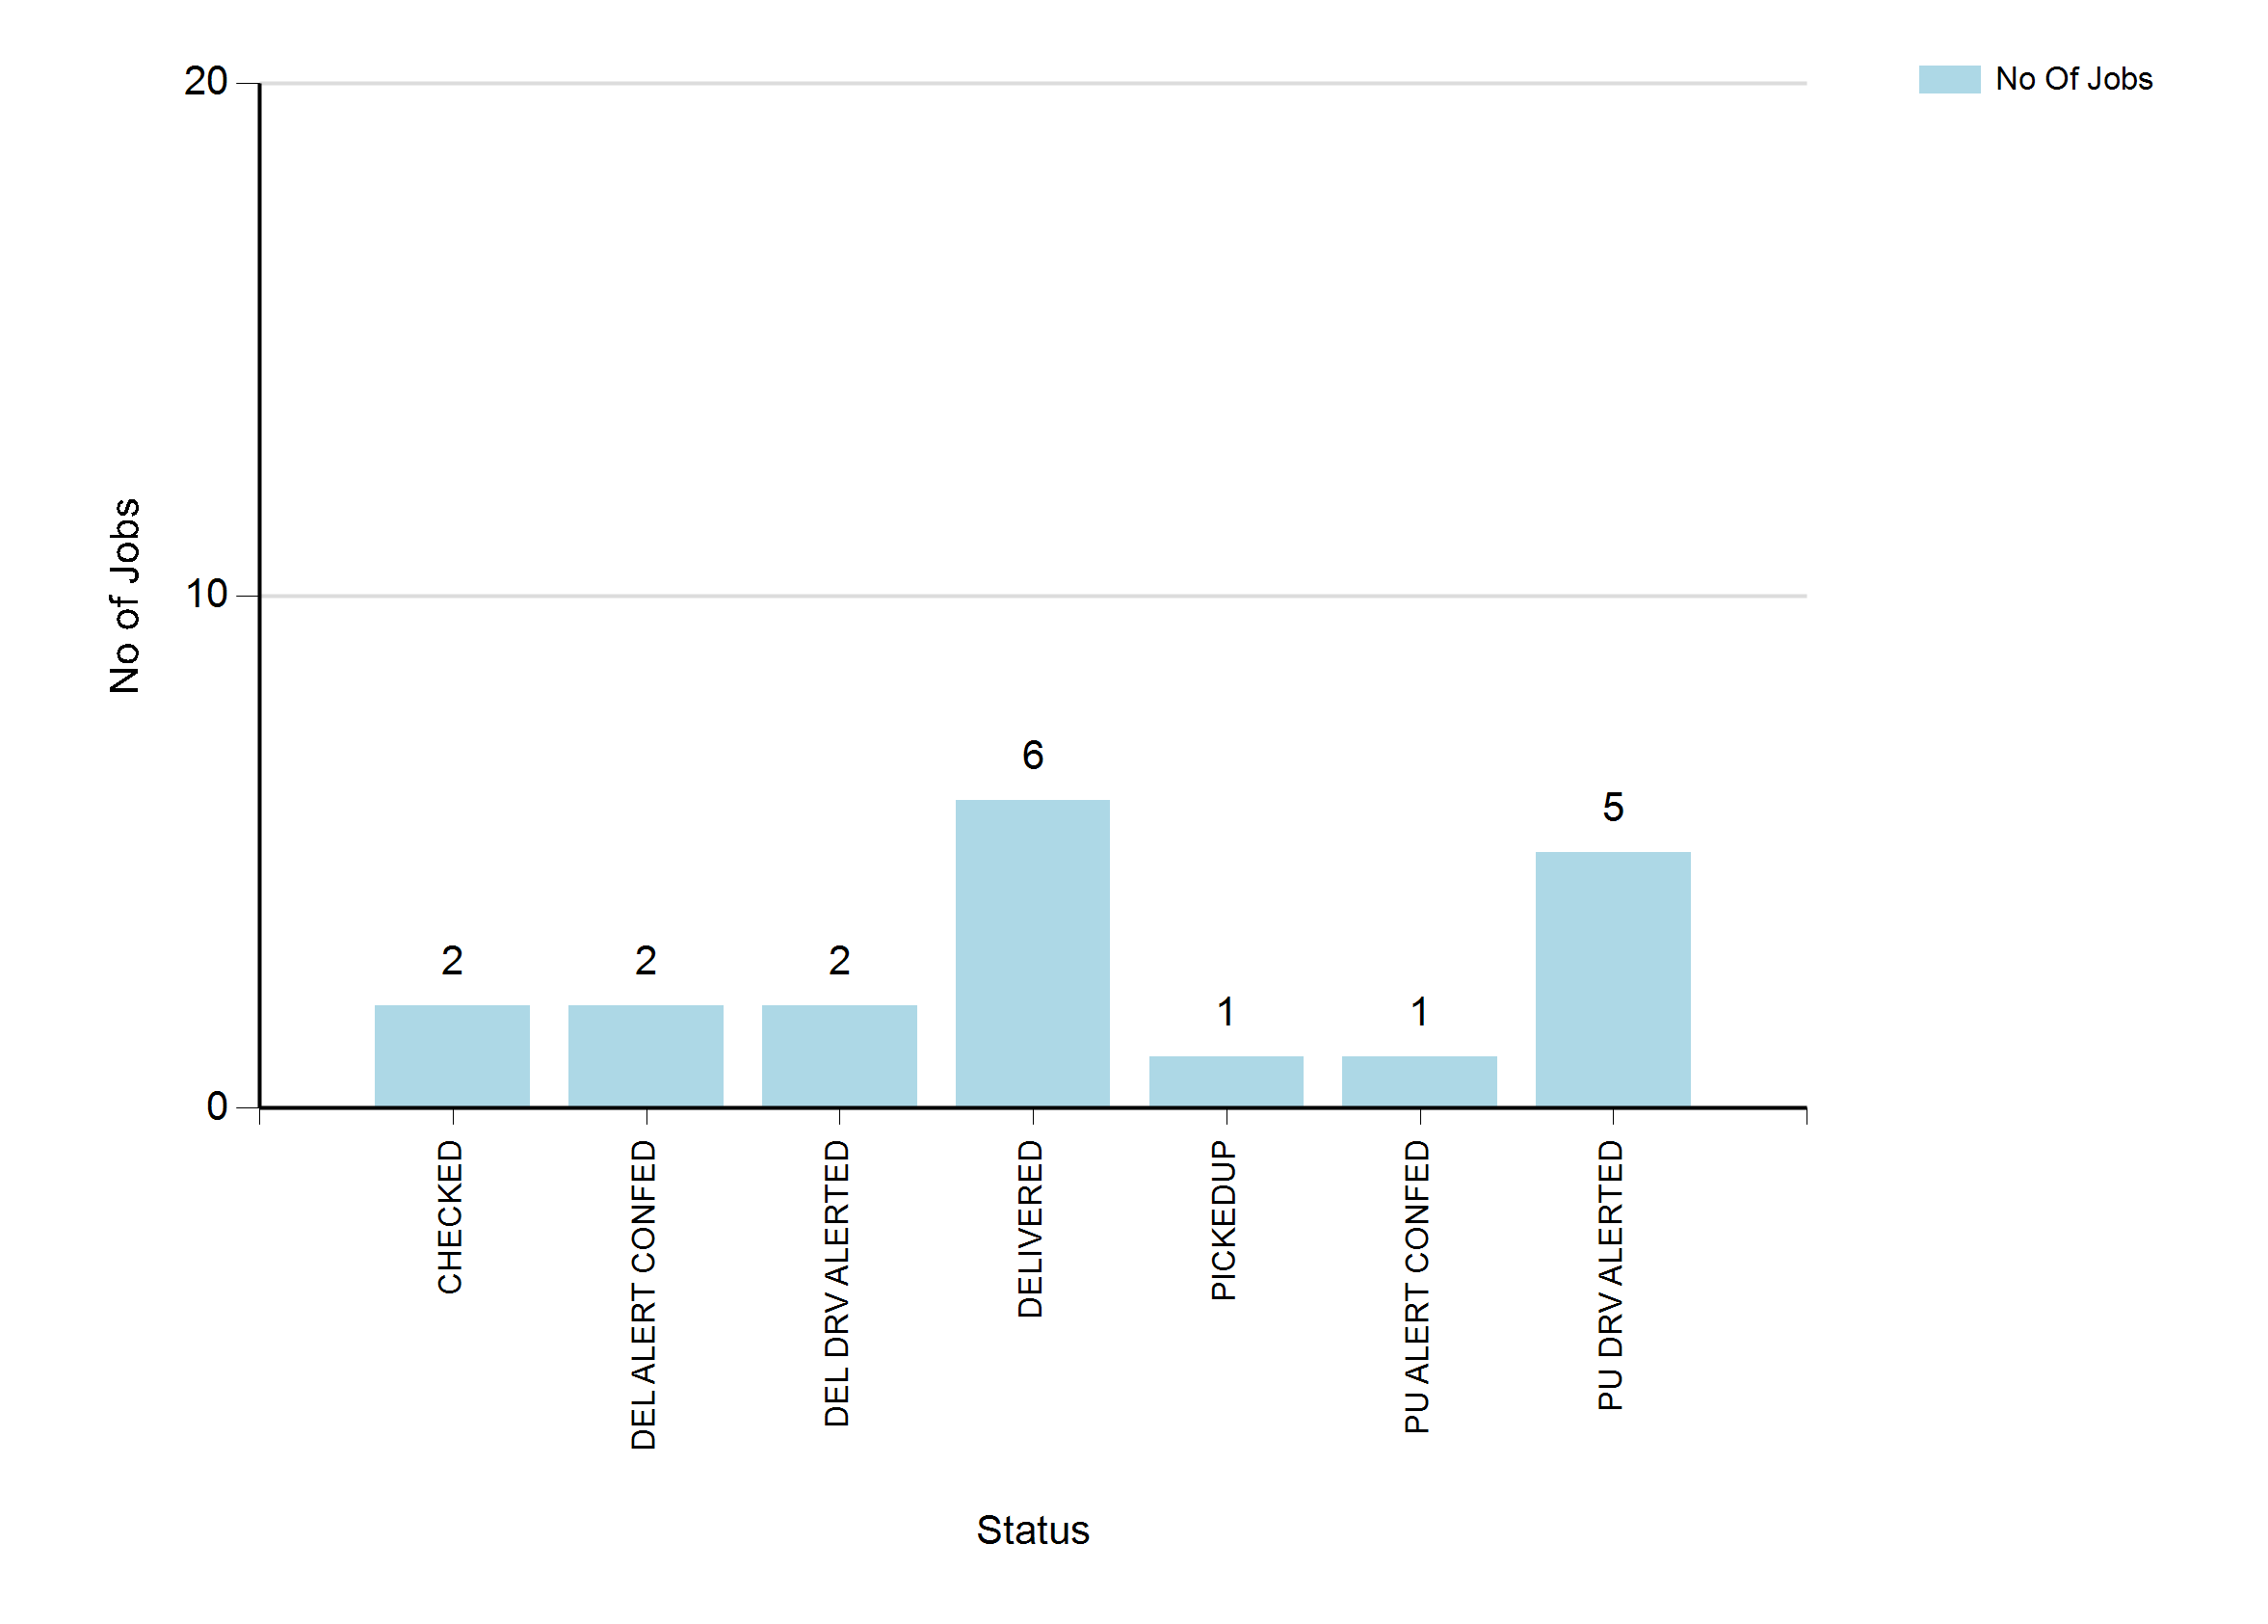
6/26/2022 9:42 PM
Print User : automation
Page 2 of 3

Slide 3
6/26/2022 9:42 PM
Print User : automation
Page 3 of 3

